Slide 1

State of Alabama
Managed Services Provider (MSP) Contract Program Overview

Slide 2
Agenda
Managed Services Provider Contract
1
Introductions & Meet the Team
4
Contractor Transitions
2
Company Contract Experience
5
VMS Demonstration
3
SLA Metrics and Reporting
6
Q&A

Slide 3




Meet the team
Managed Services Provider Contract
Linda Leiby
Scott Edwards
Cindy Sullivan
Chris Tilley
Director, Contingent Workforce Solutions
Service Delivery Manager
Executive Director, Public Sector
VectorVMS
Sr. Channel Account Manager-
Linda.Leiby@cai.io
Scott.Edwards@cai.io
Cynthia.Sullivan@cai.io
Chris.Tilley@vectorvms.com

Slide 4

We are CAI.
Services
Neurodiverse Solutions
Consulting/Advisory Services
Contingent Workforce Solutions
Cybersecurity
Intelligent Automation/RPA
Digital Services
  Application Development
  and Maintenance
  Application Modernization
  Application Rationalization
Enterprise Service Management
  Service Desk
  ServiceNow® Offerings
  Infrastructure
About Us
CAI is a global technology services firm with over 8,700 associates worldwide, serving 450+ clients in both commercial and public sector, with a yearly revenue of $1 billion+.
40+ years of excellence
uniting talent and technology for powerful results
Privately held
gives us the freedom and focus to do what’s right
Industries
Financial Services
Healthcare
Insurance
Leisure and Entertainment
Manufacturing and Supply Chain
Public Sector
Retail
Utilities
Tailor-made solutions
for lasting results across the public and commercial sectors
Neurodiversity trailblazers
leading the way to bringing neurodiversity to the enterprise

Slide 5

Contingent Workforce Solutions
Managed Services Provider Contract
20+
Years of Experience Providing MSP Services
Processing Billions in Spend, and Counting…..
CAI serves as a Managed Services Provider for Public Sector Entities since 2004
National purchasing programs for state, county, city, local government, municipalities
T&M for Staff Augmentation and SOW’s for Project delivery supported
45,000+
Engagements
2,000+
International Provider Network
600+
State and Local Participating Agencies
$4B+
Total Program Spending

Slide 6
MSP Program Contract Experience
Managed Services Provider Contract
Client | Start Date | End Date | MSP Related Services
WMATA | 2023 | Present | T&M and SOW
District of Columbia | 2017 | Present | T&M and SOW
Sourcewell National Contract- U.S. | 2017 | Present | T&M and SOW
Arkansas | 2006 | Present | T&M and SOW
Delaware | 2010 | 2022 | T&M
Florida | 2021 | Present | T&M
Georgia | 2019 | Present | T&M and SOW
Idaho | 2022 | Present | T&M
Indiana | 2022 | Present | T&M and SOW
Iowa | 2012 | Present | T&M and SOW
Michigan | 2016 | 2021 | T&M
New Jersey | 2008 | Present | T&M
North Carolina | 2015 | Present | T&M
Ohio | 2012 | 2015 | T&M
Pennsylvania | 2004 | 2015 | T&M
Virginia | 2006 | Present | T&M and SOW

Slide 7
MSP Program Overview
Managed Services Provider Contract
NASPO Value Point Master Contract awarded to CAI 11/1/2023.
  Contract Term: 3 years, with the option to extend up to 3 additional years.
Program includes both Staff Augmentation (T&M) and SOW services.
CAI’s role is to facilitate the process, providing AL personnel with the information and resources needed to execute quickly.
VectorVMS is utilized to facilitate the staff augmentation and project workflow process.
Process Alignment: Our goal is to align our program offerings with AL’s existing processes, forming one cohesive, results-driven solution.
Rate Card: Not-to Exceed (NTE) Rate Card uses Bill Rate/Vendor Rate Model.
Supplier Management: The ability to leverage AL’s current trusted supplier relationships with additional support from CAI’s trusted partners.
Compliance Management: Compliance adherence built into the process to ensure all suppliers and engagements are contractually compliant to avoid risk.

Slide 8
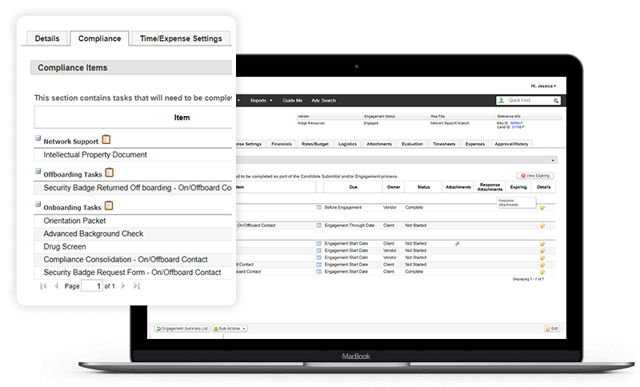
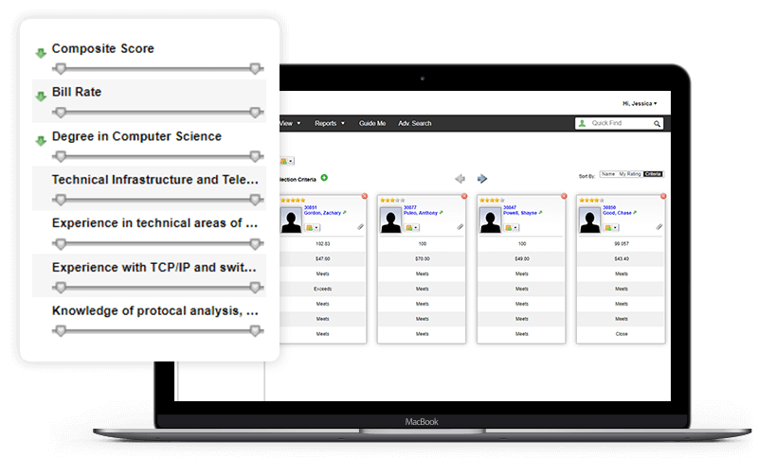
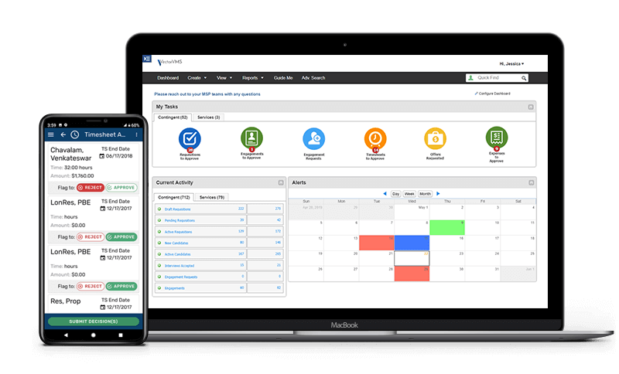
VectorVMS® Application Overview
Managed Services Provider Contract
Vendor Management System used for the fulfillment lifecycle
Software as-a-Service (SaaS)
WCAG 2.0 Level AA Compliant
Standard Integration Capabilities with Top-tiered ERPs
Single Sign-On (SSO)
Mobile App Capabilities
Easy to Use
Facilitates Process Workflow
Email notifications
Business Intelligence & Analytics

Slide 9
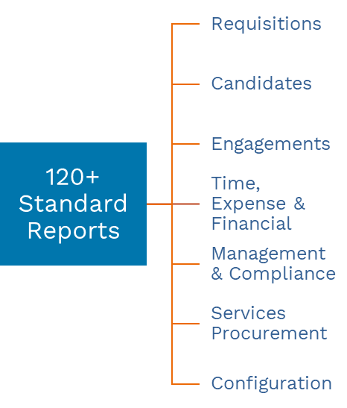
Business Intelligence In Real Time
Managed Services Provider Contract
Business Objects
(licenses included)
Ad hoc reporting
Business Intelligence
Scheduled Auto-Delivery Management
Real-time reporting
Modify standard/create custom reports

Slide 10
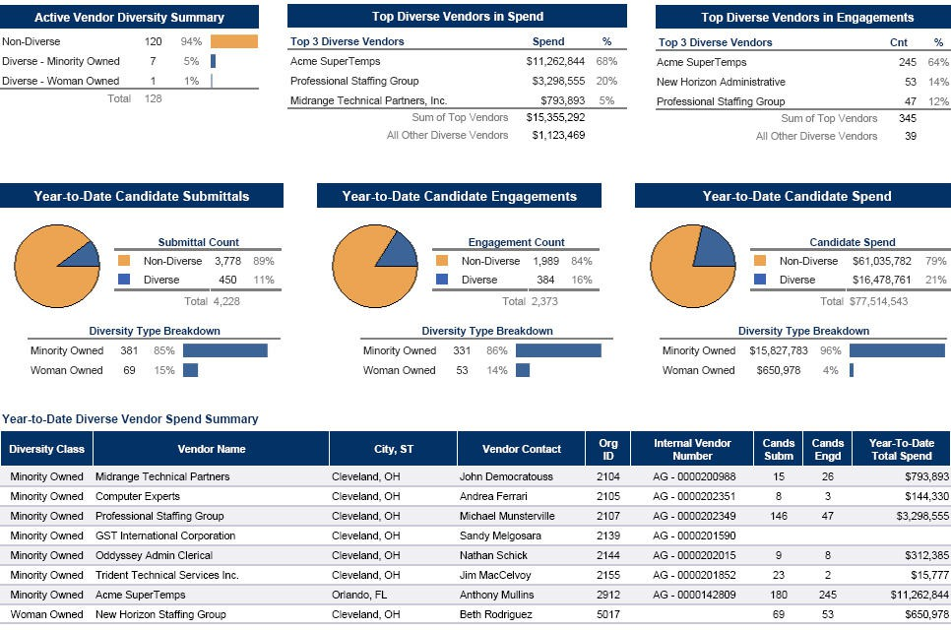
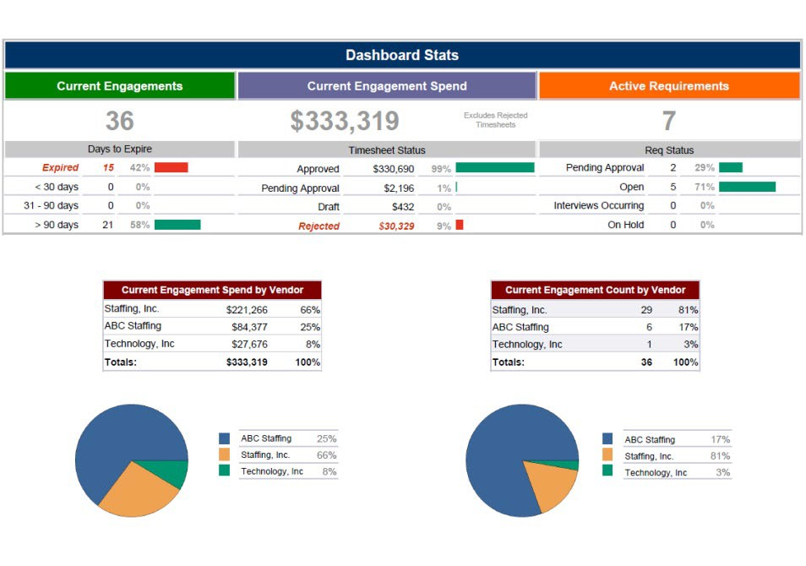
SLA Metrics and Reporting
Managed Services Provider Contract
VectorVMS provides thousands of individual data points, allowing for in-depth reporting and complete transparency
SLA Metrics pulled from VectorVMS datapoints
CAI will work with you to determine your reporting needs and provide any requested or desired reports, automated and at any interval

Slide 11
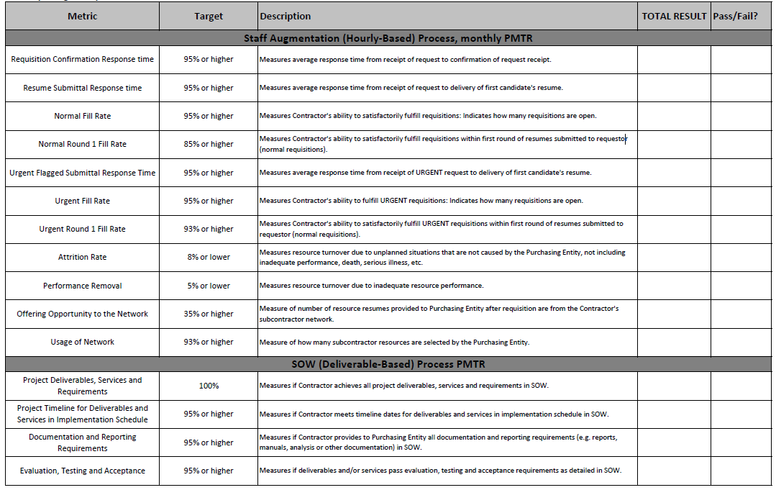
Master Agreement SLAs
Managed Services Provider Contract

Slide 12
Managed Services Provider Contract
Reporting Demo

Slide 13










Contractor Transition Overview
Managed Services Provider Contract
1. Data Collection/Crosswalk
CAI obtains incumbent Contractor data from OIT/Agency in preparation for contractor transition
2. Transition Determination
Agency finalizes details for transitioning contractors and timing (run out POs or transition immediately)
3. Transition Req Release
CAI AM prepares and releases VectorVMS req to initiate transition process for each transitioning contractor
4. Submit
Supplier submits transitioning contractor against VectorVMS req, agreeing to rate
5. Engagement Review & Finalization
CAI AM verifies candidate submission for accuracy and compliance. Contractor is engaged, transition completed
+
CAI facilitates the transition process based off Agency direction
Agency makes all procurement decisions based on Agency’s needs, driving continuity of service
CAI provides guidance in response to any obstacles that arise
CAI openly communicates with incumbent suppliers throughout transition to address any challenges
CAI provides frequent updates throughout transition, so OIT/Agency leadership are informed
Key:
CAI
Agency
Supplier

Slide 14
Staff Augmentation Workflow Process
Managed Services Provider Contract
1. Consult
CAI Account Manager (AM) consults with Agency and qualifies need
2. Create
Agency creates the request in the VectorVMS® System
3. Validate & Release
CAI AM validates the requirement for completeness and releases to supplier network
4. Submit
Supplier submits candidates
5. Qualify & Forward
CAI AM screens candidates and forwards qualified candidates to Agency within four business days
+
10. Evaluate
CAI AM consults with Agency to review resource work and completes evaluation in the VectorVMS® System for Supplier feedback
6. Review & Interview
Agency reviews qualified candidates and selects interviewees
7. Coordinate
CAI AM coordinates the interview and on-boarding process
8. On-board & Verify
Supplier facilitates background checks and onboarding documents -CAI AM verifies and approves
9. Start Work
Candidate is engaged in VectorVMS, begins assignment, and submits timesheets each week
CAI uses VectorVMS® for facilitation of the contract workflow process
We have partnered with VectorVMS® (formerly PeopleFluent) for over 20 years
Key:
CAI
Agency
Supplier
Candidate

Slide 15





SOW Workflow Process
Managed Services Provider Contract
1. SOW Service Request
2. SOW Review
3. Release SOW
4. SOW Response Submissions
5. SOW Response Review
6. Award Decision
7. Engagement
8. Project
9. Finalization
Key:
CAI
Client
Supplier

Slide 16

VectorVMS Demo
Managed Services Provider Contract

Slide 17
CAI’s Approach –
Speed AND Quality
Managed Services Provider Contract
CAI’s best practices within Contingent Workforce Management have been derived from over 20 years implementing, delivering, and supporting large public sector MSP client programs.
Thorough requirement creation/validation captures position-specific details and information that suppliers need to provide strong candidates, and accurate SOW proposals.
CAI’s experienced and long-tenured Account Management Team(s) screen and shortlist candidates, providing Top 3-5 candidates within 4 business days, with high level of accuracy.
More than a score: Our screening goes beyond a system-generated score.
We facilitate the entire workflow, quickly and efficiently, so you can focus on your business.
We are here to provide support throughout the duration of the engagement lifecycle to assist and ensure delivery competency.

Slide 18

Questions

